Slide 1
Introduction to Python and Pandas
DataHacks 2020 Workshop

Slide 2
Python?

Slide 3
Python Programming Language
Interpreted
Object-oriented
High-level programming language
with Dynamic semantics
???????
Fun fact:
Python isn't named after
the Python snake,
but after the comedy TV show
‘Monty Python’s Flying Circus’

Slide 4
Interpreted
Interpreted languages are not directly executed by the target machine.
Different from compiled programming languages
Here, the source code has to be converted into machine-readable code
Read and executed by some other computer program called interpreter

Slide 5
Object-Oriented
Python, like any other Object-Oriented Programming (OOP) languages, is organized around objects.
Everything in python is an object
Lists
Dictionaries
Classes
…and so forth

Slide 6
High-level programming language
The syntax of the code is easier to interpret by humans
Python is easily readable, and has very little syntax requirements compared to other programming languages.
If you have to display something on the screen, the built-in function is called print;
Typing print() to actually “print” something on the screen is pretty intuitive

Slide 7
Dynamic semantics ~ typing
Dynamic objects are instances of values contained into constructs in the code, and they exist at run-time level.
We can assign to one object multiple values, since it will update itself, differently from a static semantic language
If we set a=2 and then a=’hello’, the string value will substitute the integer one as soon as the line is executed.

Slide 8
Dynamic semantics ~ typing
Can’t do this in java
int a = 2;
a = ”hello” → ERROR
We can in Python!

Slide 9
How do we write & run code in Python?
With a simple text editor
Write code in python and save as [FILENAME].py
Run $ python3 [FILENAME].py in your terminal
In a work environment

Slide 10
Setting up Jupyter Notebook

Slide 11
What you need to do:
Download Anaconda. This will install Python, numpy, pandas, and allow you to use Jupyter notebooks.
Get a Kaggle Account
Download the Avocado dataset. https://www.kaggle.com/neuromusic/avocado-prices
Notes:
We will be using a dataset from Kaggle about Avocado sales from 2015 to 2018 as a jumping off point for learning different pandas functions. This is a 15min work session

Slide 12
Jupyter Notebooks?
- Jupyter notebooks are what these sessions will mainly be taught using.
- They allow for live visualization of your datasets, making it a lot easier to work with, as opposed to constantly printing information out.
Notes:
Jupyter notebooks, for me are helpful because they make it super easy to debug your program. You can basically divide up your program into chunks of code and run each part separately.

Slide 13
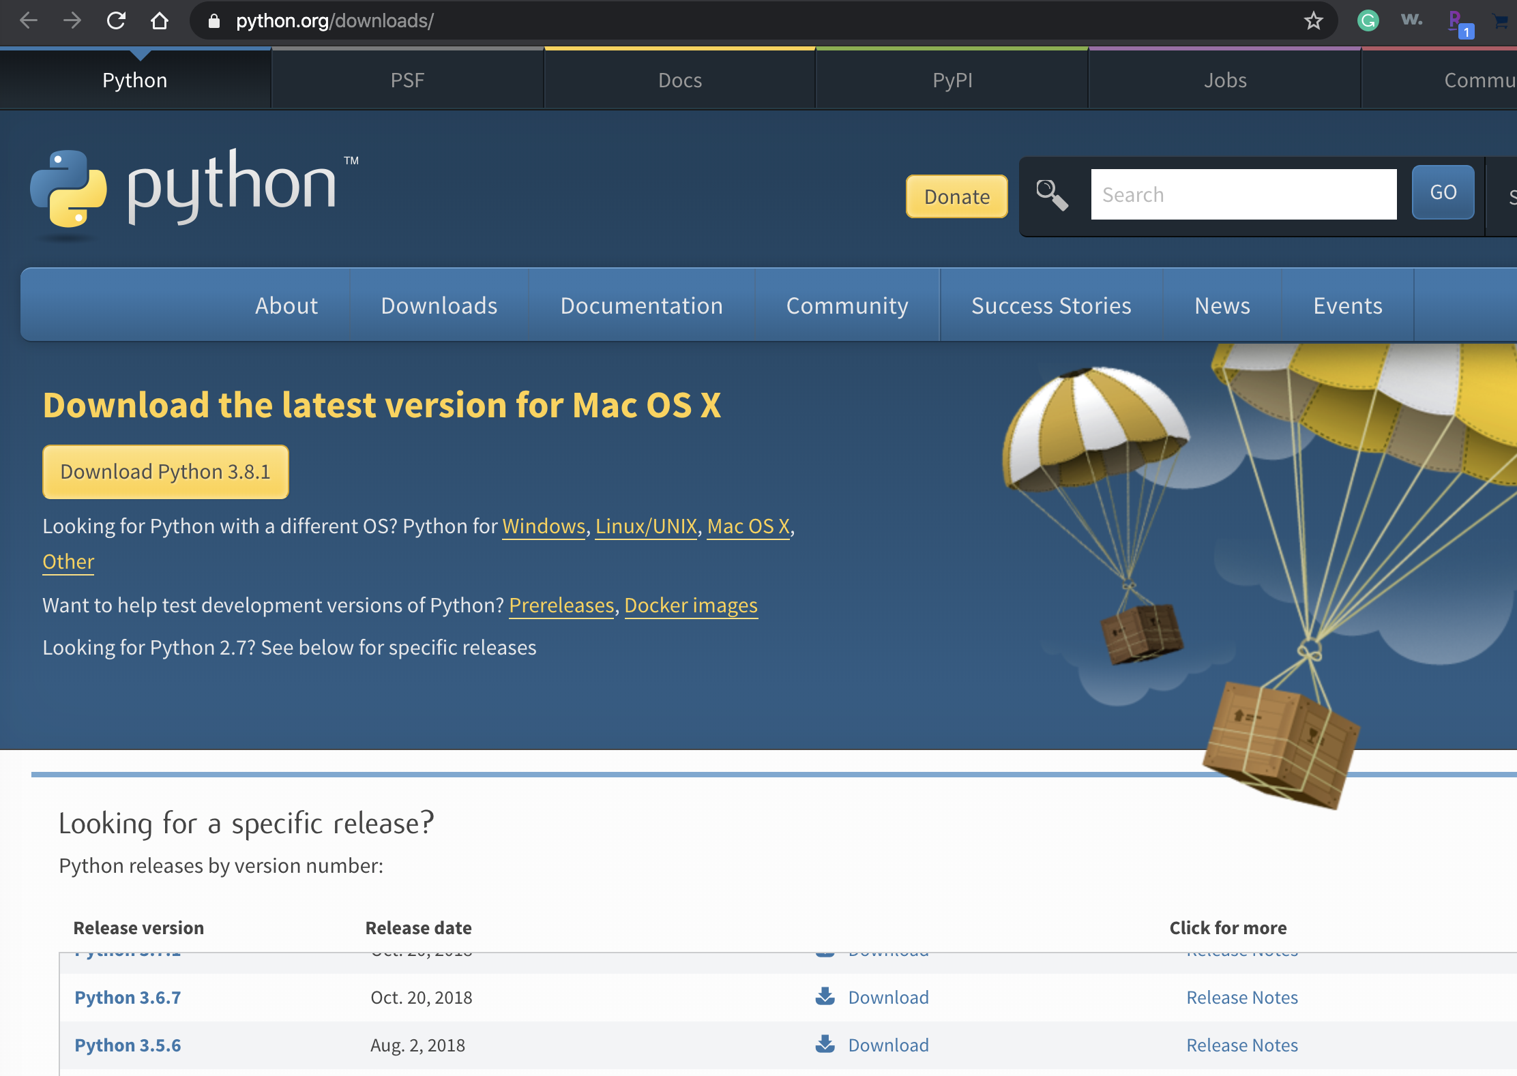
Download the most recent version of Python for your OS
https://www.python.org/downloads/

Slide 14
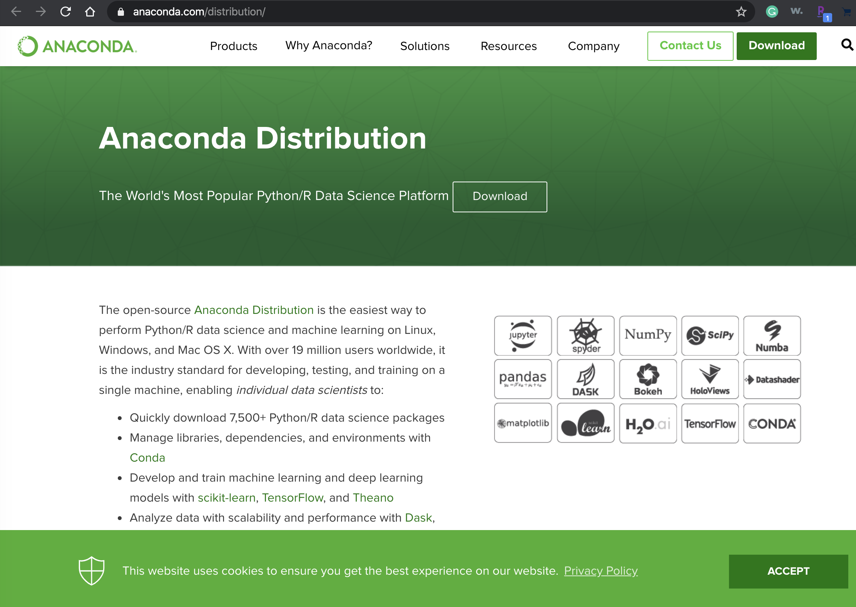
2. Download Anaconda (3.7)
https://www.anaconda.com/distribution/

Slide 15
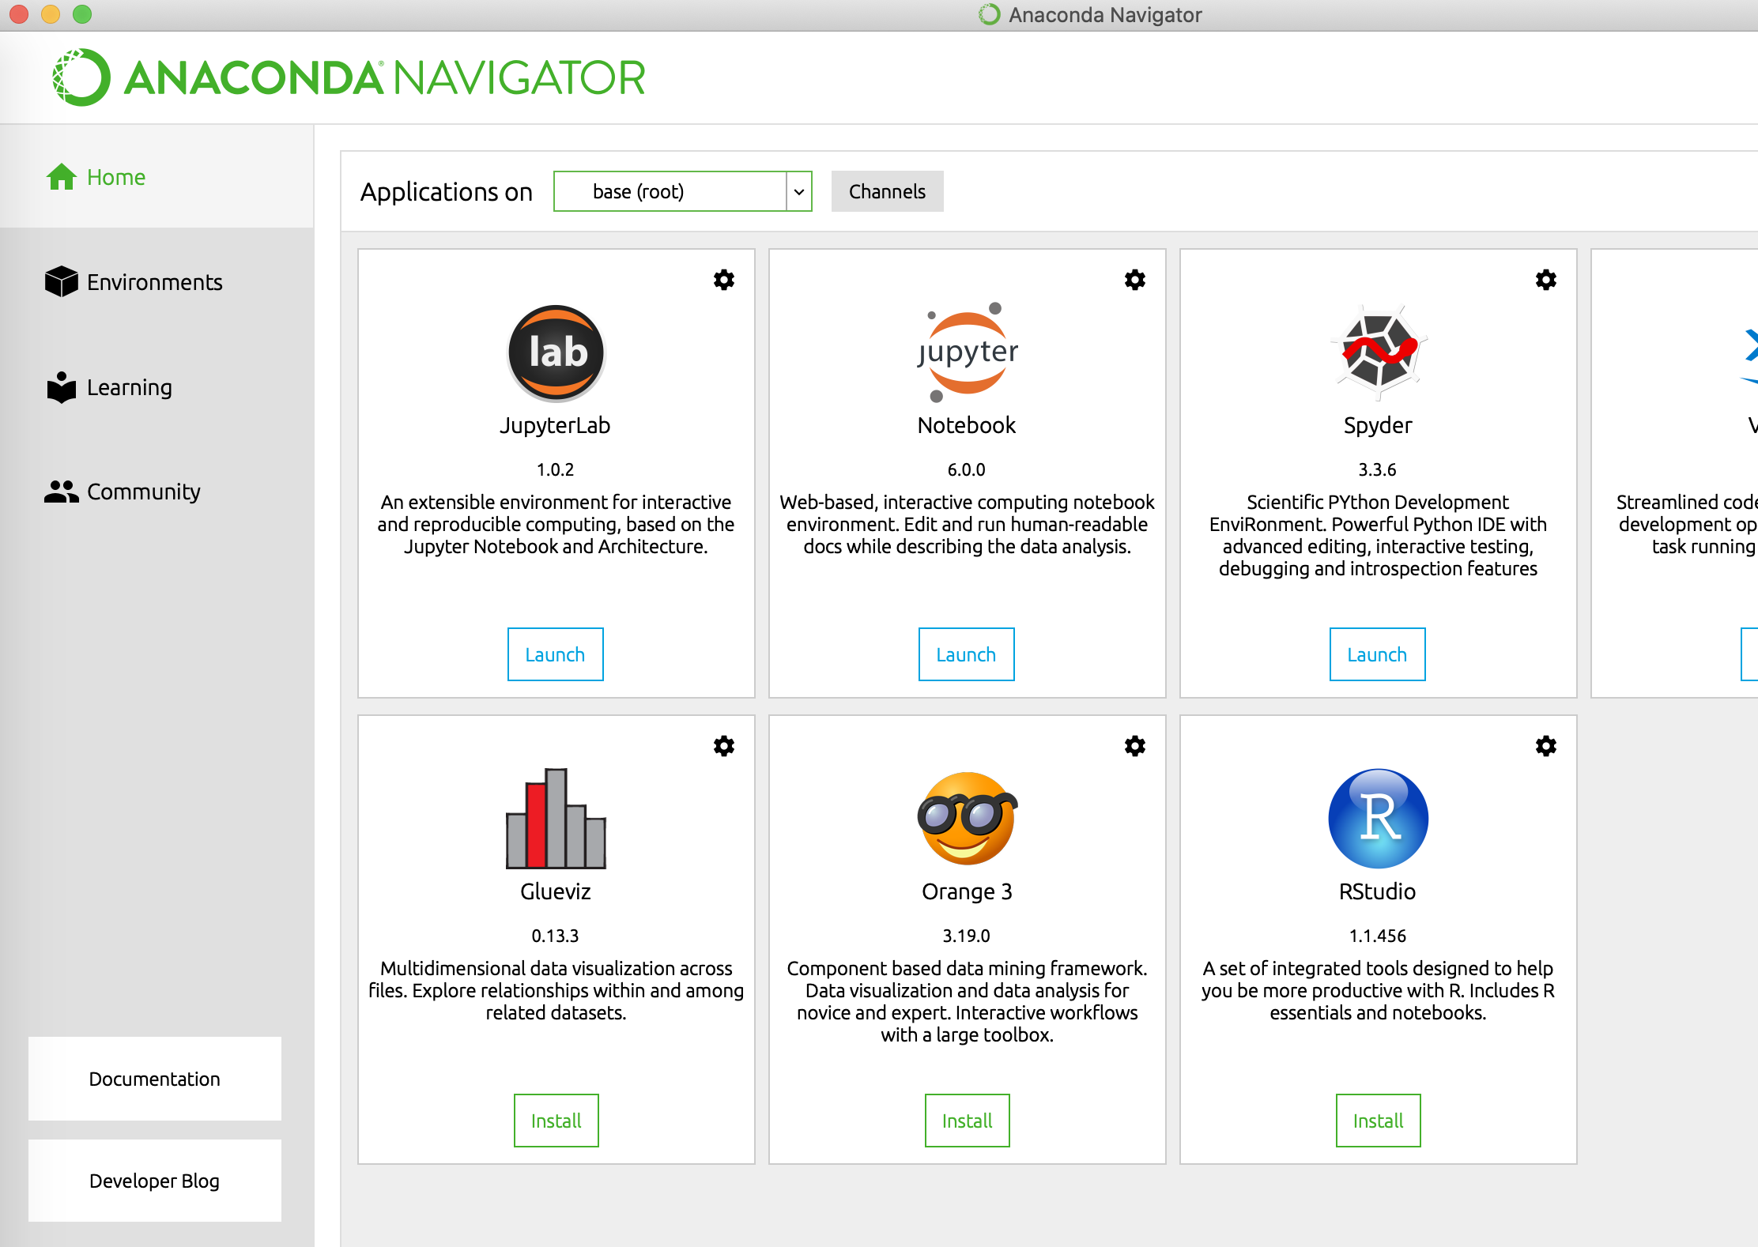
3. Launch Anaconda Navigator
Launch Jupyter Notebook
– this will be opened in your browser

Slide 16
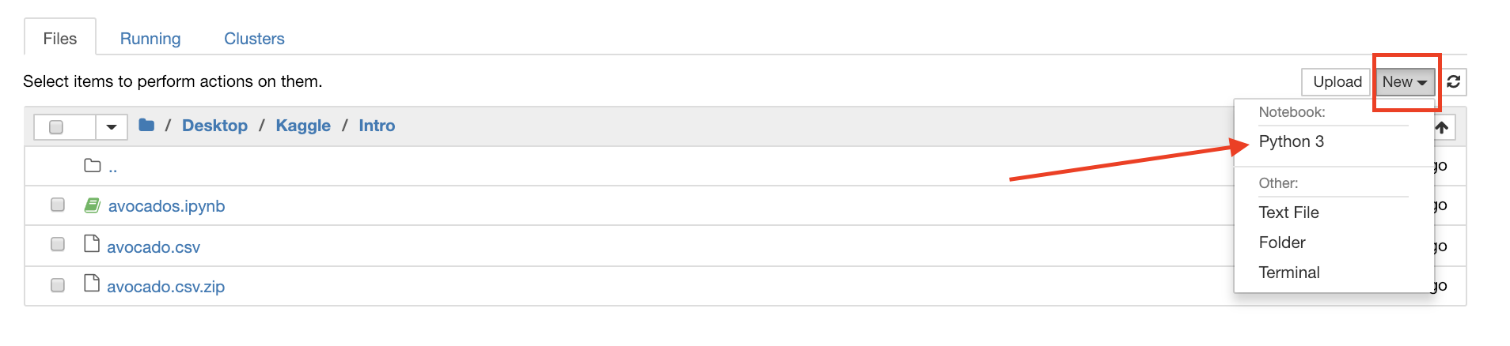
4. Make a new Notebook

Slide 17
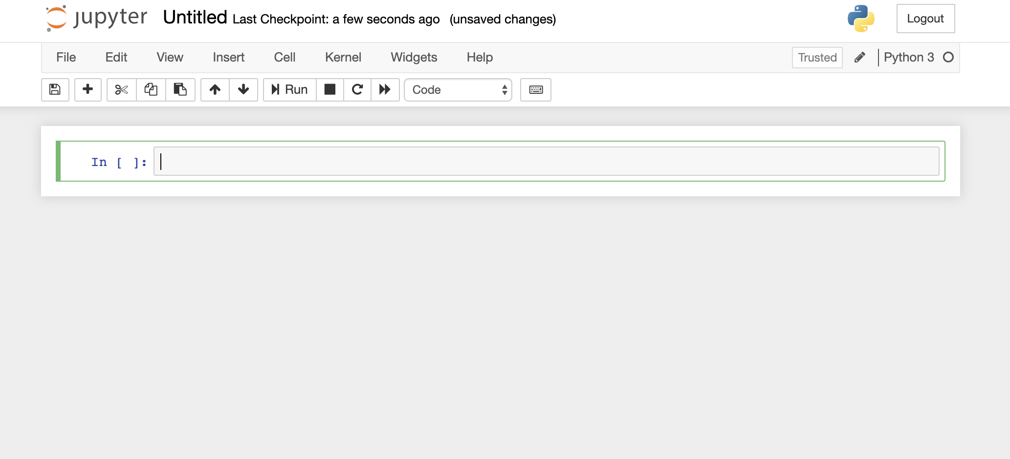
5. Done!

Slide 18
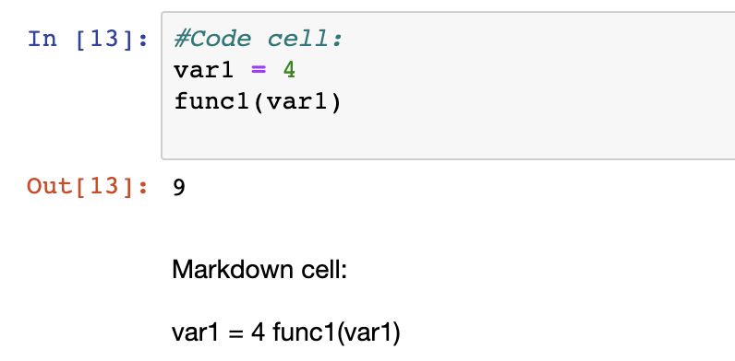
Cells in Jupyter Notebook
(DEMO)
Code
Where all the executable Python codes go!
Markdown
For text blocks

Slide 19
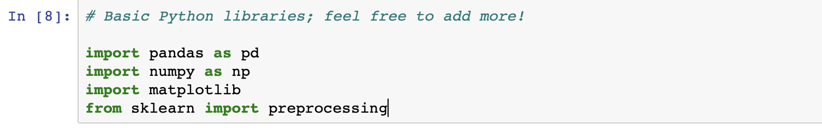
Importing libraries
Import [MODULE] //as [ALIAS; nickname for your own benefit]
from [MODULE] import [A]
Only importing A; must do each when importing other things from the library

Slide 20
Python syntax
NO MORE SEMICOLONS ;)
Whitespace in Python:
Since we’re not using semicolons to terminate lines, a newline signifies the end of a line instead
Indentations matter!
Strings can be “string” or ‘string’

Slide 21
Python identifiers
Identifier is a name used to identify a variable, function, class, module or other object
Starts with a letter A-Z, a-z or an underscore (_) followed by zero or more letters, underscores and digits (0-9).
Python does not allow punctuation characters such as @, $, and % within identifiers.
Case sensitive

Slide 22
Python Variable Types
Numbers
Strings
Individual characters are also considered strings now
List
Tuple
Dictionary

Slide 23
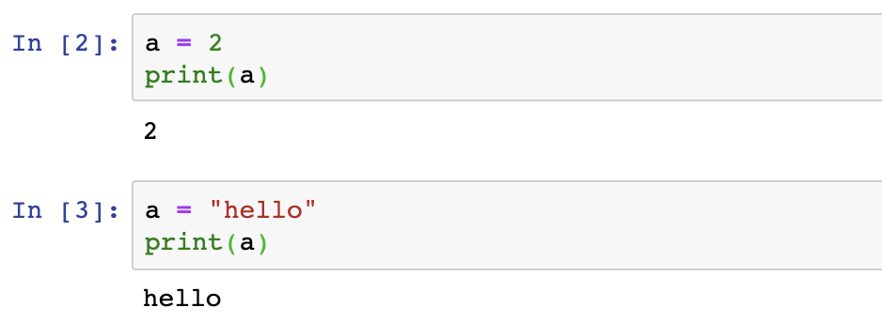
Typing in Python

Slide 24
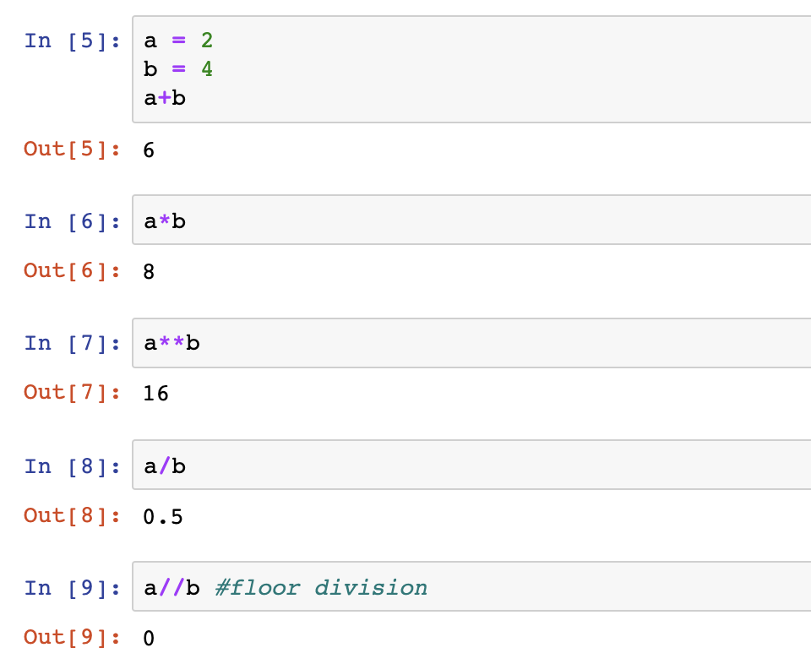
Math in Python

Slide 25
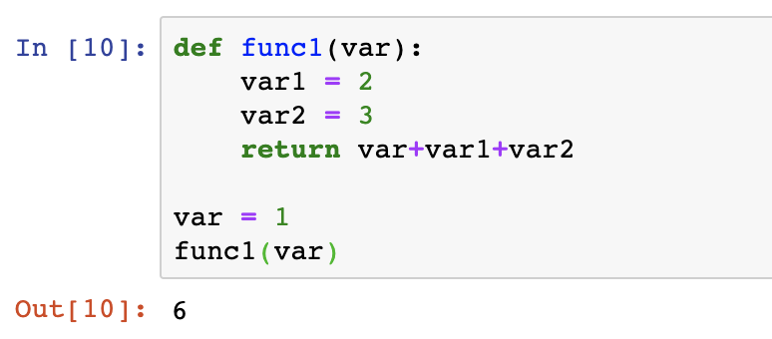
Python syntax
Functions
print()

Slide 26
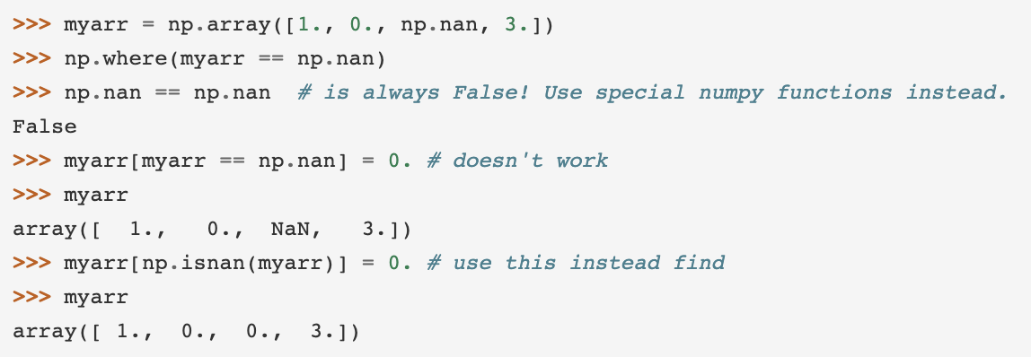
Numpy – np.NaN
can’t check equality like A == np.NaN
Use methods like is.NaN, dropna(), etc

Slide 27
Intro to Pandas
DS3 Kaggle Session #1
Fall 2019

Slide 28

What is pandas?
Pandas… nothing to do with real pandas
Python Library
Data manipulation and analysis
Good tool to use when you are working with a large dataset
Notes:
Pandas is a library for Python that allows for data manipulation and analysis. It is a powerful library with a crazy amount of features, and a very important tool to learn in order to be a successful data scientist.

Slide 29
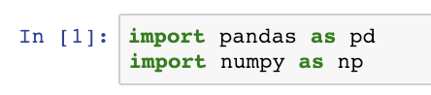
Beginning, at last!
Once you have your notebook and csv in the same directory, you’re ready to start.
The first thing to do is make sure that you have pandas and numpy imported, as they are crucial to any data related task.
Notes:
Numpy is a super handy python library that we can use for basic math operations on data structures like arrays and matrices. Built in functions to do operations like dot products, cross products, transpose. Basically make array manipulation super easy.

Slide 30
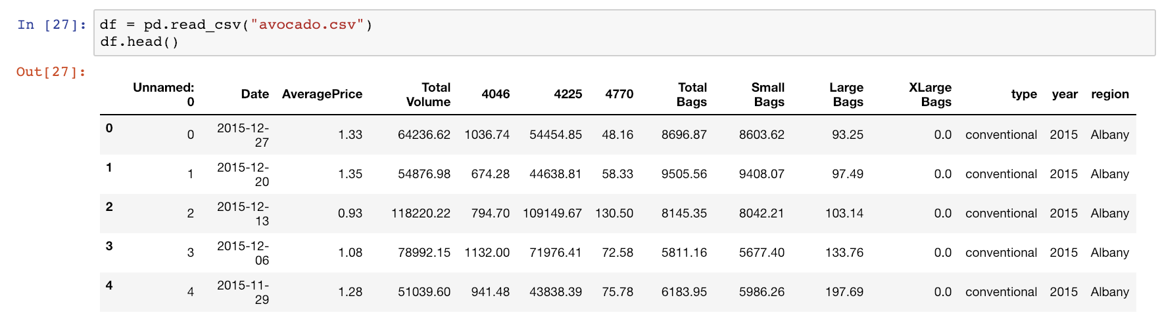
Reading
Read in your csv file using the following method:
(for documentation:
https://pandas.pydata.org/pandas-docs/stable/reference/api/pandas.read_csv.html
Notes:
You will notice a 2-D table pop up. Basically we are getting the dataset into a dataframe- You can think of it as a 2-D array of values.
Dataframes make it super easy to visualize datasets, and also to manipulate data. It is one of the most important features of pandas, and has many cool functions to help out with data manipulation.

Slide 31
What’s a head?
You can see the top few elements of your dataframe using DataFrame.head(). This avoids displaying more of the dataset than is currently needed, and is a nice way of confirming that everything has loaded correctly.
Notes:
Basically helps us get an idea of what the data looks like. What would you do to get the first 3 lines - df.head(3)

Slide 32
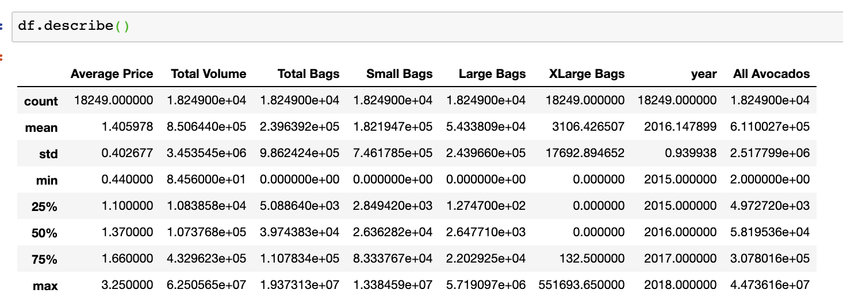
Describing Data
You can use describe() to quickly gather some general insights on your dataset.

Slide 33
Data Cleaning
Most important part of ML process
Select columns to work with.
Make sure no values are missing.
Add new columns with combinations of features.

Slide 34
Dropping Columns
Now we can start doing some data cleanup. You may see the ‘Unnamed: 0’ column and wonder what its purpose is. It is just the index but repeated, so we don’t need it anymore.
Your first task: drop this column using df.drop()!

Slide 35
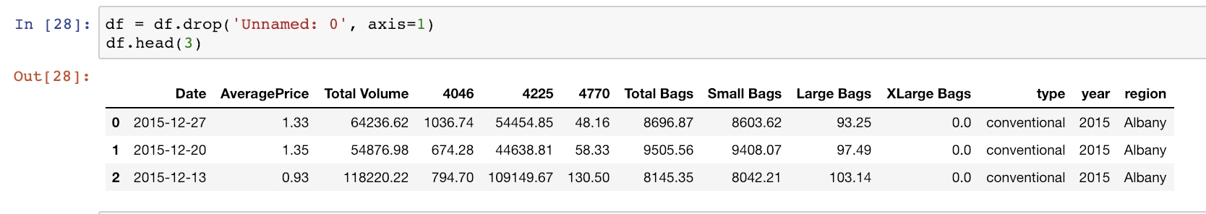
Solution
Notes:
Axis = 1 - whether to drop label from the column(1) or row/index(0) - its 0 by defualt.

Slide 36
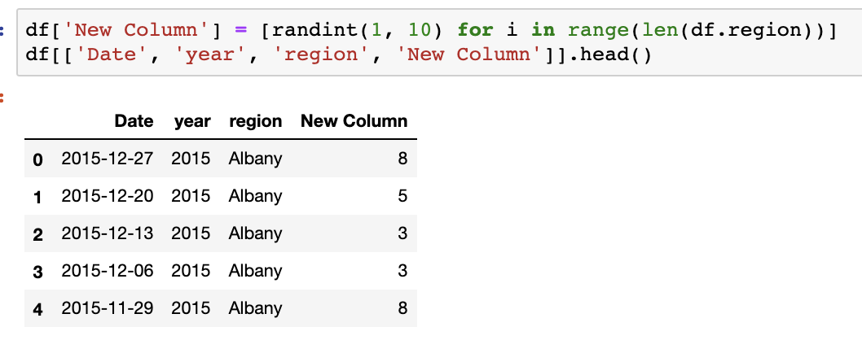
Adding Columns
You may want a new column. Just pick a name and throw some data in:

Slide 37
Renaming
It’s nice to be able to quickly read what column names are. The column “AveragePrice” could be changed to have a space in between, to match the formatting of the other columns.
Task 2: Rename “AveragePrice” to “Average Price”

Slide 38
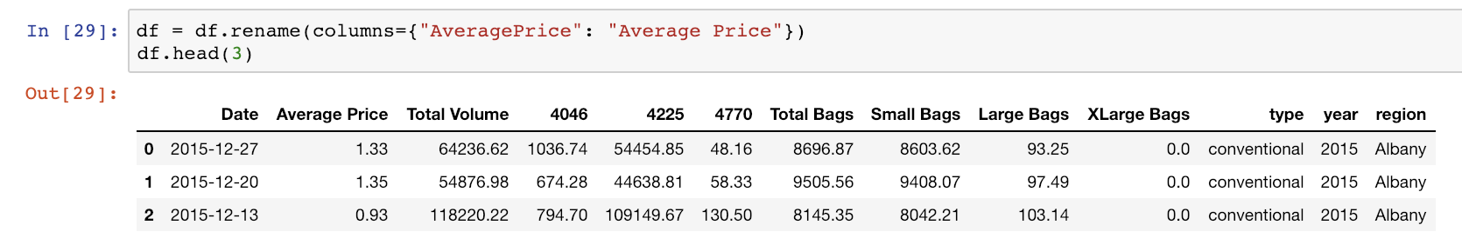
Solution

Slide 39
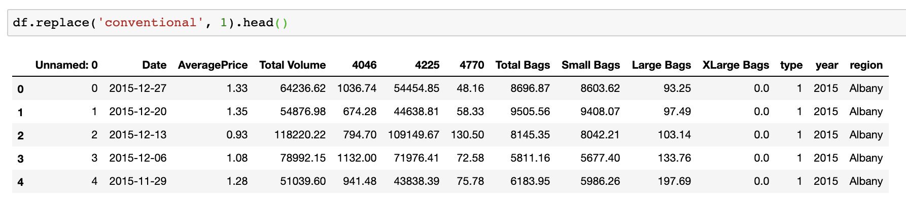
Replacing data

Slide 40
Null values
Your choice on how to deal with these (but be sure to fit the context of the data!)
Drop them
Fill them with the mean
Fill them backwards or forwards
Fill them with whatever you want

Slide 41
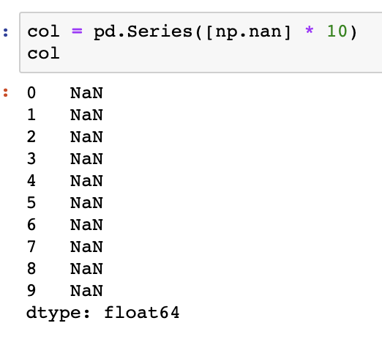
Null values
Here’s a bunch of null values.
How can we fill these?

Slide 42
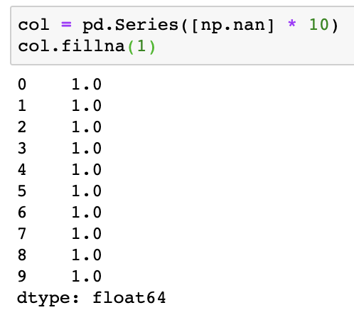
Null values
Fill using anything!

Slide 43
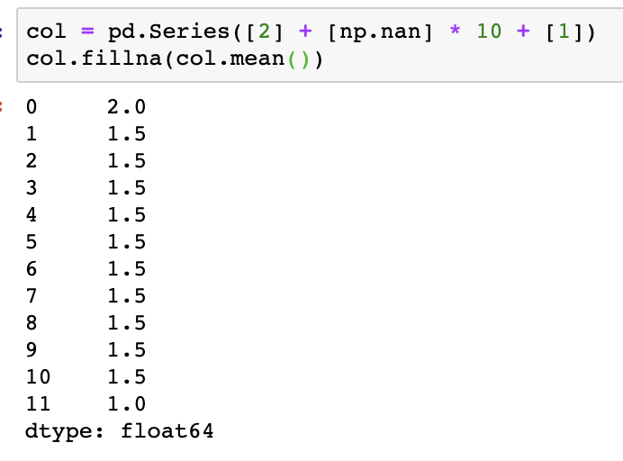
Null values
Fill using the mean

Slide 44
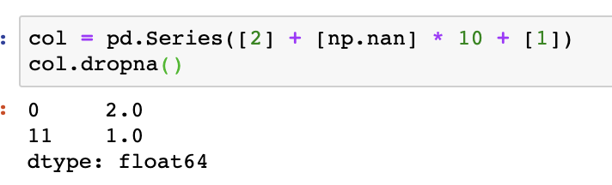
Null values
Or get rid of them completely!

Slide 45
Selecting Data
How can we select data from a DataFrame? There are a couple different ways.
We can pull data out using indexing by column, using dot notation, or by using the actual index of a column.

Slide 46
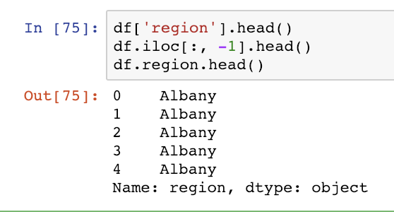
Examples
All three of these lines get the exact same thing: the ‘region’ column of the DataFrame as a pandas Series.

Slide 47
Selecting Data
All three of these lines get the exact same thing: the ‘region’ column of the DataFrame as a pandas Series.

Slide 48
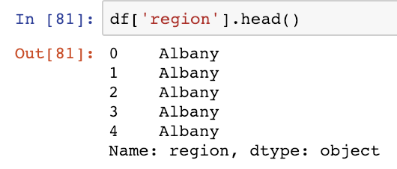
Selection by Column
You can get access to a column by using its name in the same kind of format as you would access an element from an list using its index.

Slide 49
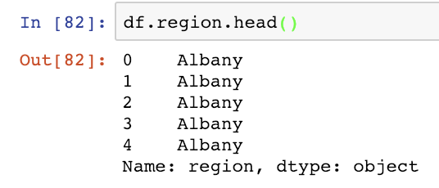
Selection by Column v2
You can index the exact same way, as before, although instead of using brackets ‘[ ]’, you can just directly use the name of the column. There is no real difference in the two, it is personal preference. The main downfall is that it cannot access columns with spaces in the name.

Slide 50
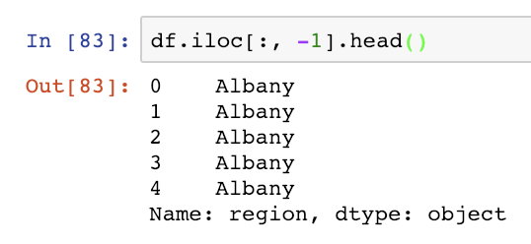
Selection by index
.iloc[<row(s) index>, <col(s) index>]
Selection using iloc works by specifying the row as the first parameter, and the column as the second parameter. In this case, ‘:’ indicates that we want every row, and -1 means that we want the last column.
More on iloc and loc in a second.

Slide 51
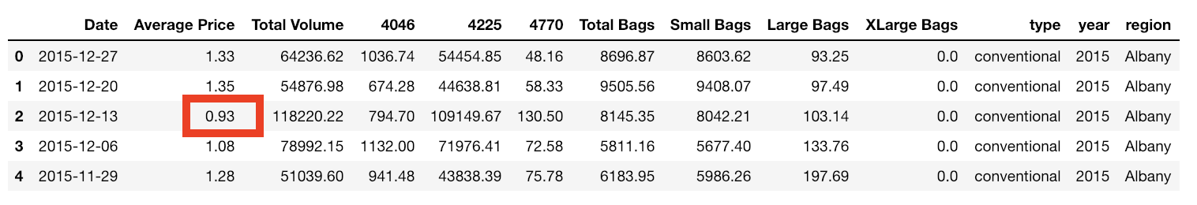
Selection by Index Example
How would you access the 3rd row (index 2) and get the Average Price of that row?
Notes:
df.iloc[2,1]

Slide 52
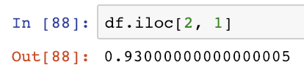
Solution

Slide 53
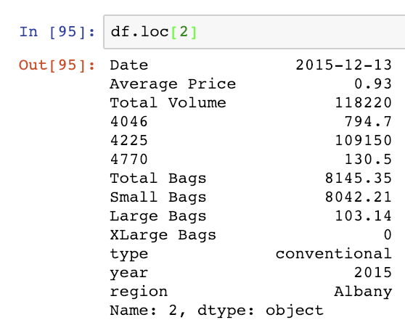
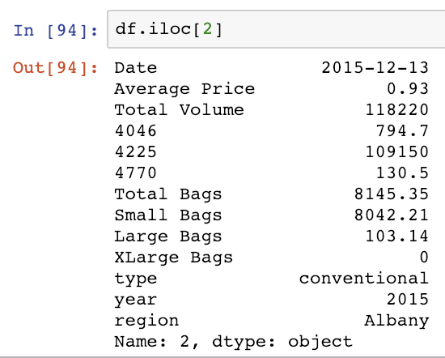
.loc vs .iloc
Both .loc and .iloc can pull out specific rows.

Slide 54
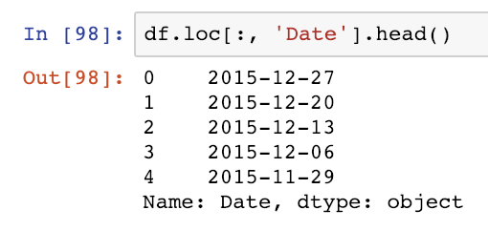
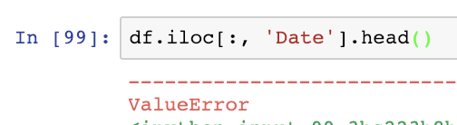
.loc vs .iloc
.loc can index by the string name, .iloc indexes by integer.

Slide 55
DataFrame vs Series
You may have noticed when working with iloc and loc, we get a different looking output than out DataFrame. These are pandas Series, which are just the data type that a column (or row) is stored in.
A Series is a one-dimensional array containing information from a row or column.

Slide 56
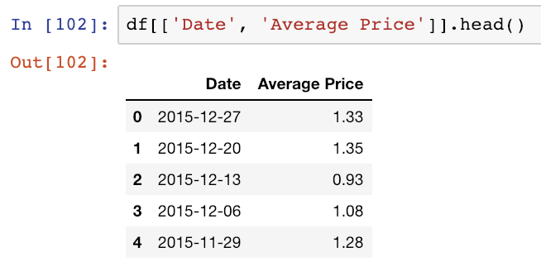
Selecting Multiple Columns
You can select multiple columns by putting each column name in a list.

Slide 57
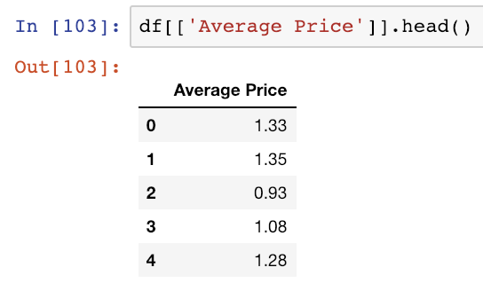
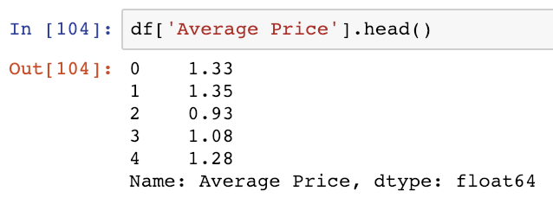
Quirky!
It also works for single columns! Look at the difference between selecting a Series and selecting a DataFrame.

Slide 58
Useful pandas functions

Slide 59
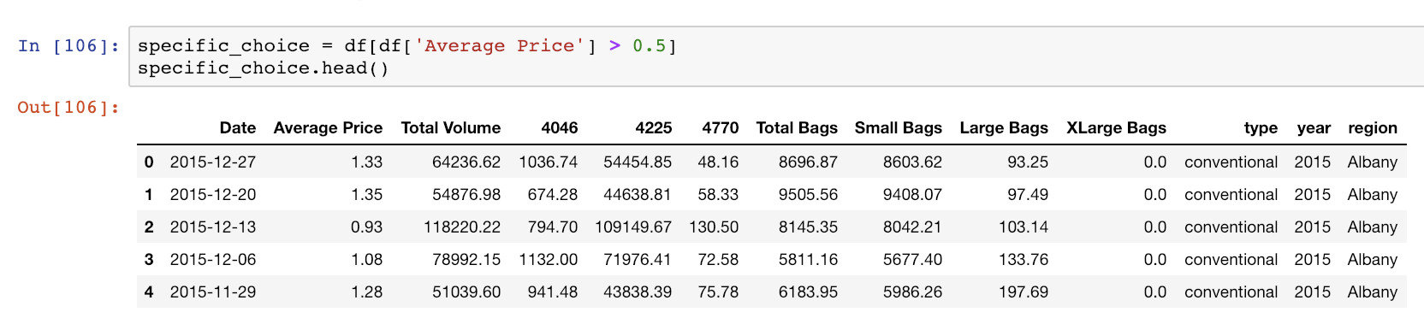
Selecting Data - Conditionals
Use conditionals to select only specific data based on criteria.
This is selecting only data from the ‘Average Price’ column that is greater than 0.5.

Slide 60
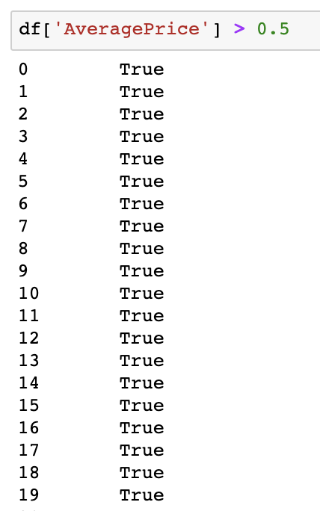
Selecting Data - Conditionals
How does this work?
Boolean series

Slide 61
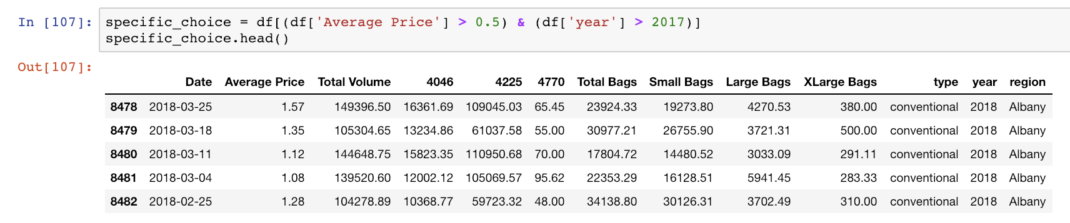
Selecting Data – Multiple Conditionals
What if you want more than one condition to select data?

Slide 62
Operators
These conditionals utilize different operators
& for AND, | for OR

Slide 63
Exercise
Pull out all the avocado sales in the ‘SanDiego’ region that are from 2017, and are below 0.75 average price.

Slide 64
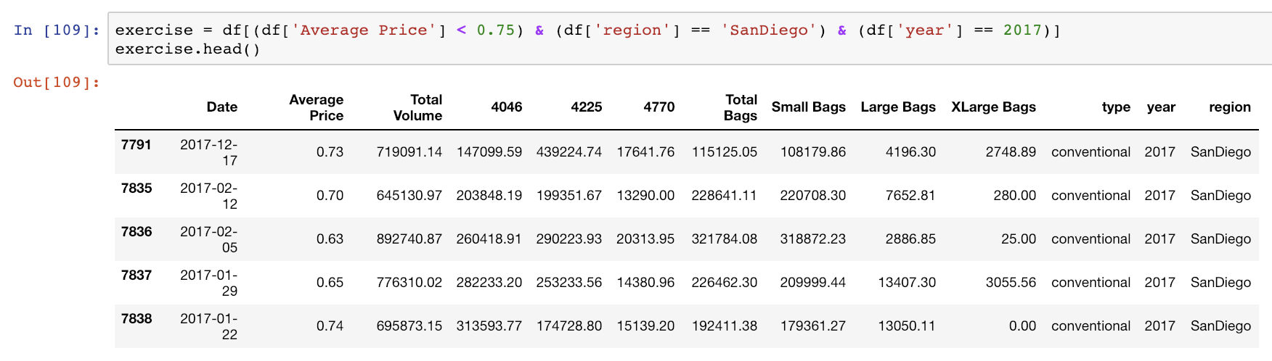
Solution

Slide 65
Proportions
Do you want to know what proportion of the Total Volume of avocado sales San Diego makes up? Great, because that’s relatively straight forward!

Slide 66
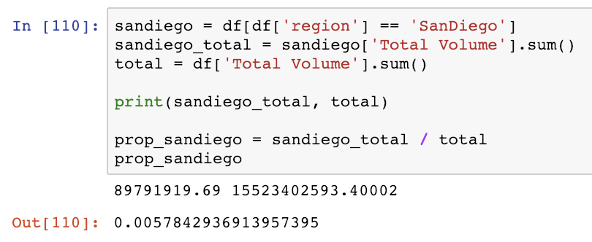
Summing and Dividing
You can sum a column or DataFrame’s columns by using the .sum() function. We can select our region to be ‘SanDiego’ and sum its volume, then sum the volume of the entire dataset.
From there we can calculate our proportion.

Slide 67
Exercise
What is the proportion of region ‘Atlanta’ and ‘Denver’ total bags of the full total bag sales?

Slide 68
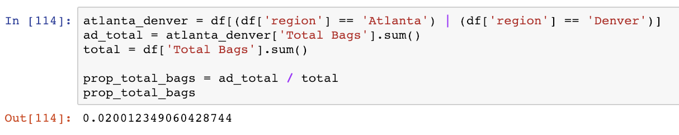
Solution

Slide 69
Applying
What if you wanted to subtract a number from an entire column? What if you wanted to use some specific function for every entry in a column?
That’s where apply comes in. You can pass a function into an apply call, and it will perform that function on every element in the column.

Slide 70
Subtract the Mean
We are now going to subtract the mean Total Volume from the Total Volume category.
First we need to get the mean, then create a simple lambda function to apply.

Slide 71
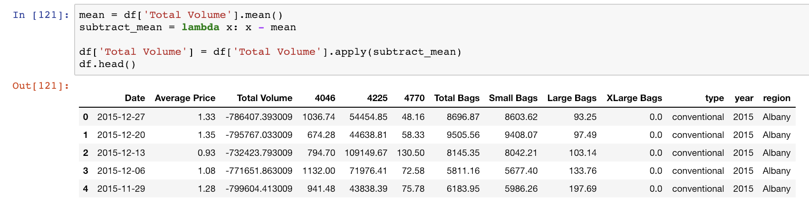
Code
It’s that easy!

Slide 72
Grouping
- You can take a DataFrame and group the entire thing based on the unique values of a column, then aggregate how you feel.
- Picking how you want to aggregate your information and setting a function up can be the tricky part.

Slide 73
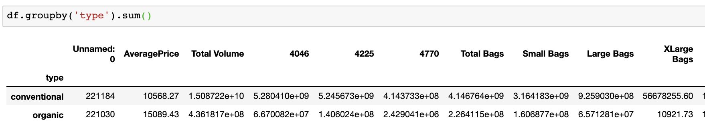
Grouping
Simple example: group based on type of avocado, sum together each column of the groups.

Slide 74
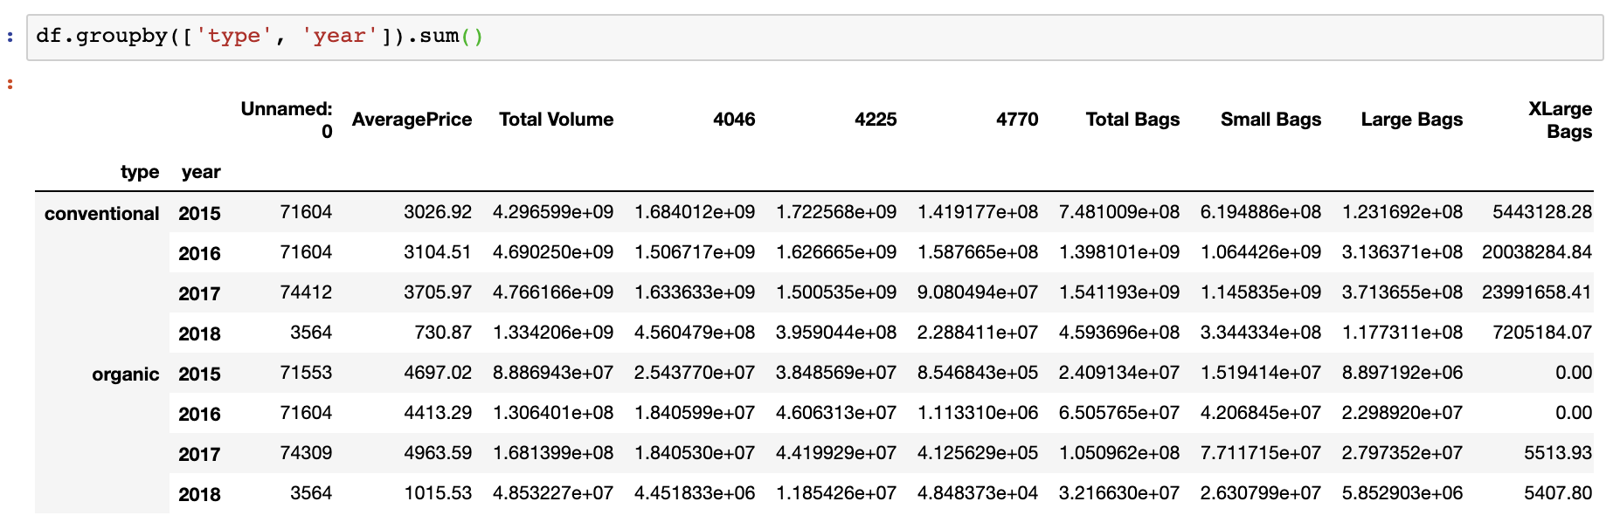
Grouping
You can also group on multiple columns!

Slide 75
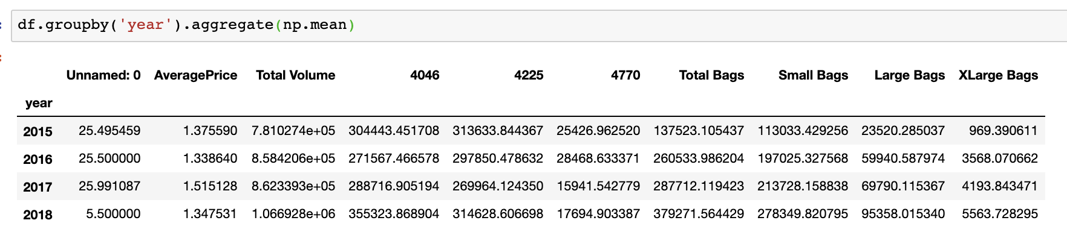
Grouping - aggregate
Use your own functions to group everything using .aggregate

Slide 76
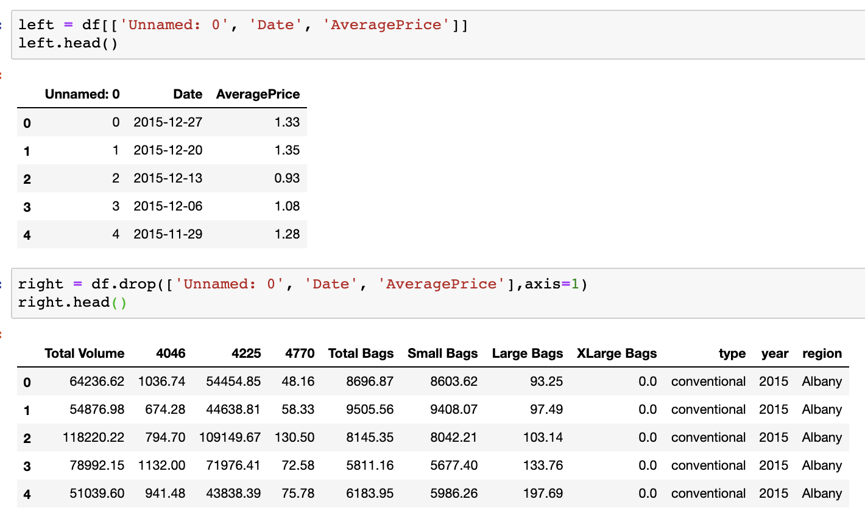
Merging
If you have two tables
that have matching
information, you may
want to merge them.
Notes:
Same avocado dataset but spilt into two

Slide 77
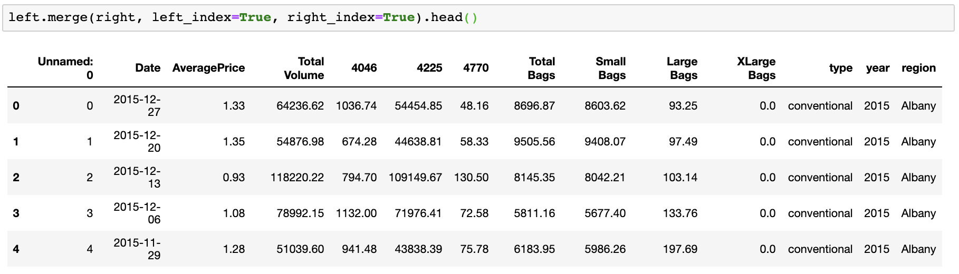
Merging
Like this:

